Slide 1
IoT Using LoRaWAN
CSE3PRB - Team F

Slide 2

Team
Michael Owczarek
Joel Morran
Remi Petit
James Curnow
Luis Shigetomi
Notes:
Introduce self. Forget about roles.

Slide 3
Agenda / Purpose
System overview
System Architecture
ER Diagram
Agile Reflection
System Implementation
Testing
Q&A
Notes:
The team clearly states why they are there today. What they hope to get out of the presentation and what they’re going to cover in this presentation.(5)

Slide 4
System Overview
A network capable of receiving and storing sensor data in a database on the cloud. Using the stored data the system can display a range of different views and graphical representations in a meaningful way to users through the use of Power BI software.
Benefits of the system
Data is received in real time
GPS tracking
Graphical data representation
Data can be filtered by time
Capable of generating reports with data
Notes:
The team correctly and accurately identifies all of the benefits the final product provides to the end users. They also identify any client defined constraints they have had to work within. (5)

Slide 5
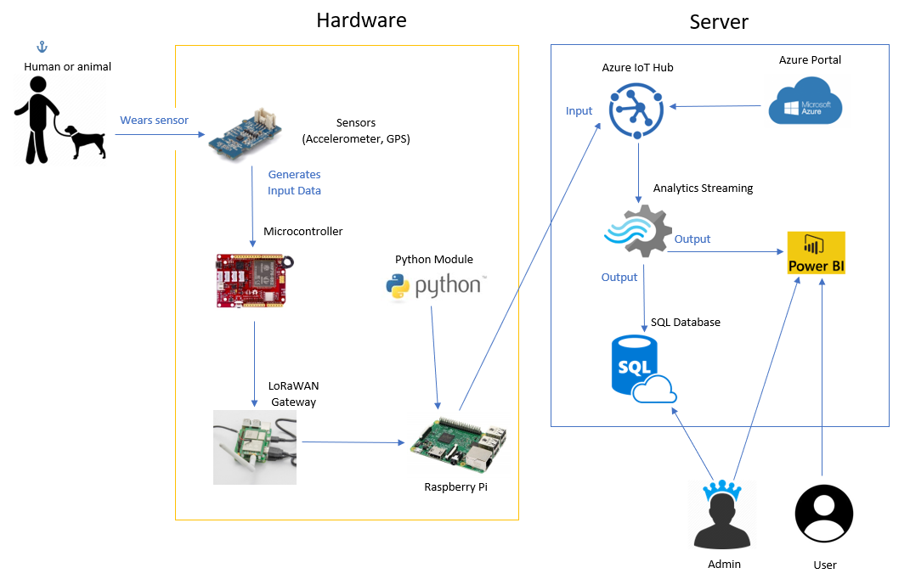
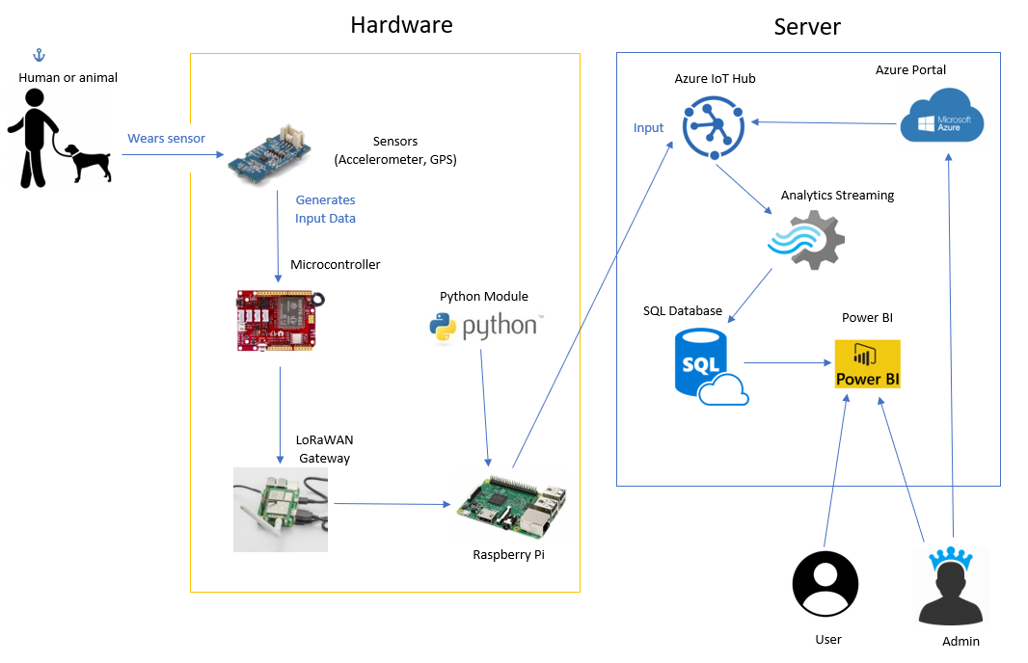
System Overview OLD
Notes:
MICHAEL

Slide 6
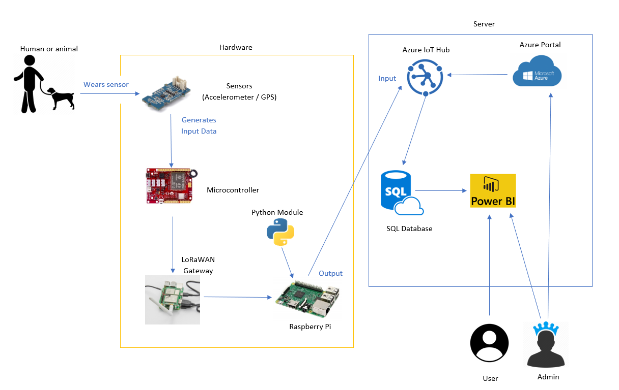
System Overview Final
Notes:
MICHAEL

Slide 7
Constraints
Has to be long range and work with low amounts of data
Needs to be made smaller to fit onto the animals
Needs to be simple to use to that non tech savvy people can use it on there own
Has to have low power usage for long tracking up time
The cost of running the Azure deployment must be considered as running a stream analytics job can be very cost intensive

Slide 8
Constraints cont.
The project inherits any constraints from the systems and components (Azure, Power BI, Raspbian, etc.) that it utilises.
The LoRaWAN gateway requires a strong, stable network in order to function properly and send each packet to Azure.
Power BI also requires a persistent internet connection

Slide 9
domain model showing or UML component diagram

Slide 10
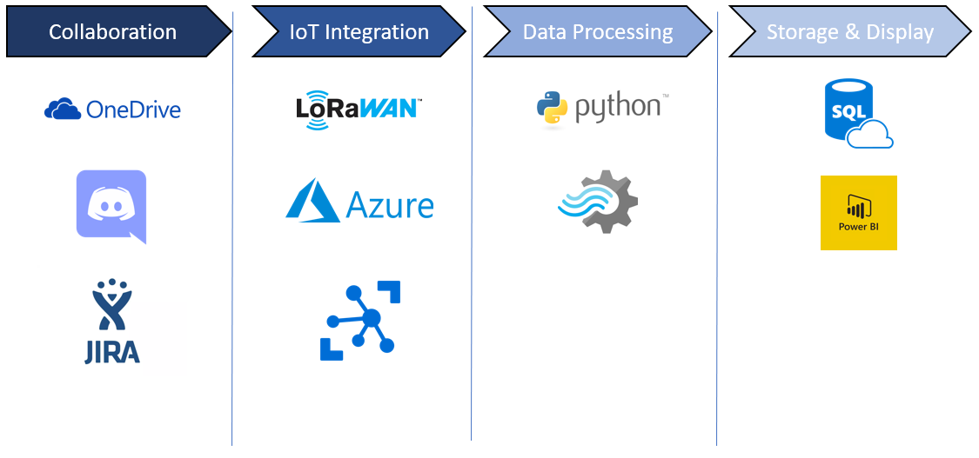
Tech Stack

Slide 11
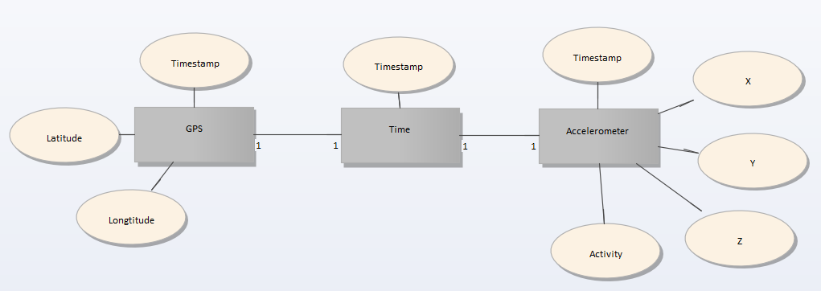
Entity Relationship Diagram
The figure below shows the relationships between all the entities we utilize for data collection.
Notes:
The team clearly shows either
· A domain model showing all of the relevant entities and relationships that make up the problem domain. This can take the form of a UML class diagram or an ER diagram; OR
· A UML component diagram that shows the major software components within their software system and the interfaces through which they interact with one another.
(5)

Slide 12
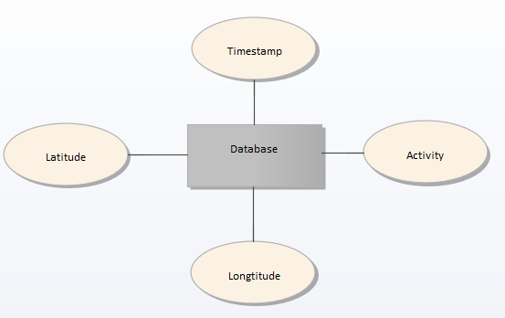
Entity Relationship Diagram
The figure below shows the attributes stored in our database. From here we pull this data and display it graphically on Power BI.
Notes:
The team clearly shows either
· A domain model showing all of the relevant entities and relationships that make up the problem domain. This can take the form of a UML class diagram or an ER diagram; OR
· A UML component diagram that shows the major software components within their software system and the interfaces through which they interact with one another.
(5)

Slide 13

Agile (Old User Stories)
As a User I want…
Clean UI / Easy to understand
Easy setup (hardware & software)
Cost effective
Data easy to export
Notes:
LUIS

Slide 14
Agile (New User Stories)
As a User I want to…
View a pie chart of the subject’s behaviour
View a heatmap of the subject’s location
Filter data by a chosen date range
Notes:
LUIS

Slide 15
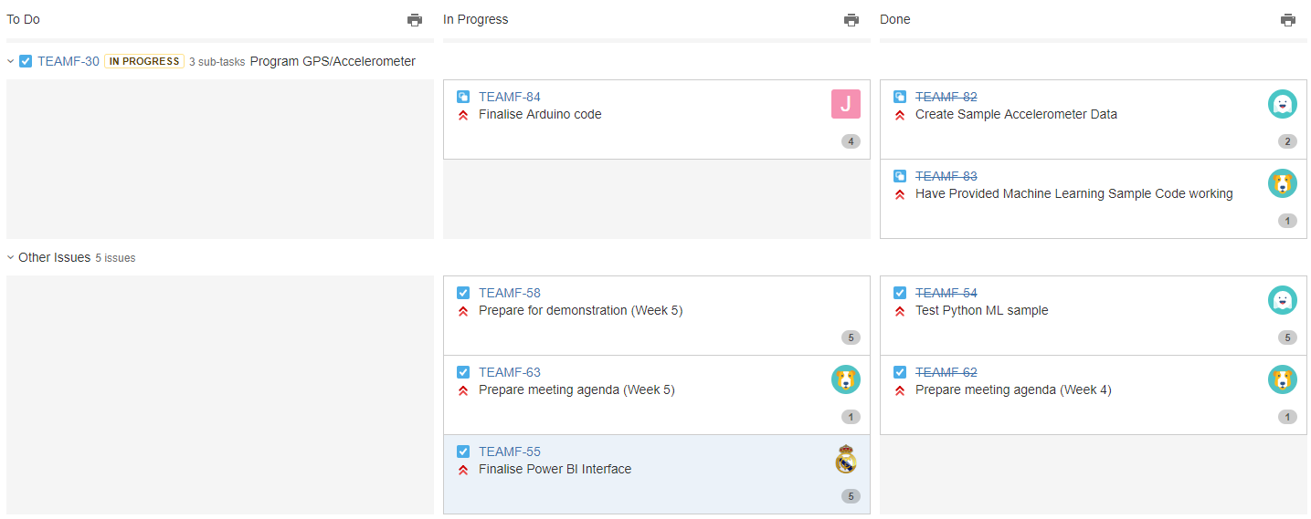
Agile (Jira)
Notes:
REMI
- Explain how the team can/has improved.
- Explain how the team can/has improved.

Slide 16
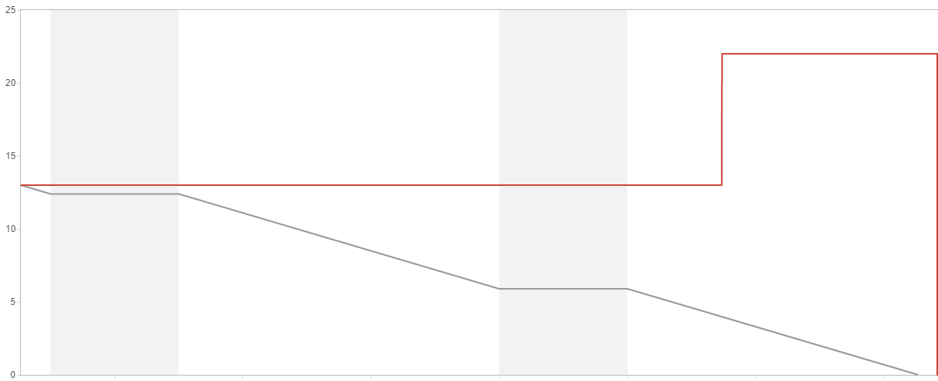
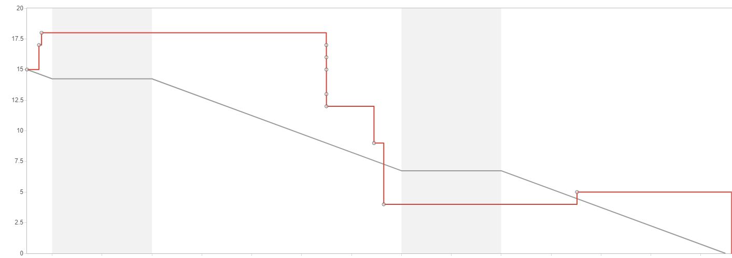
Agile Reflection
Before
After
The burndown charts above show how the team have improved using the Agile methodology in project development. We have adapted to access and update our Jira dashboard more regularly allowing us to stay focused and on task.
Notes:
The team clearly understands and reflects on the improvements they have made throughout the year with regards to agile methodologies, team cohesion, technical skills, communication and overall growth. The team uses metrics to demonstrate and compare improvement and evaluates any action plans they have implemented in the past. (10)

Slide 17
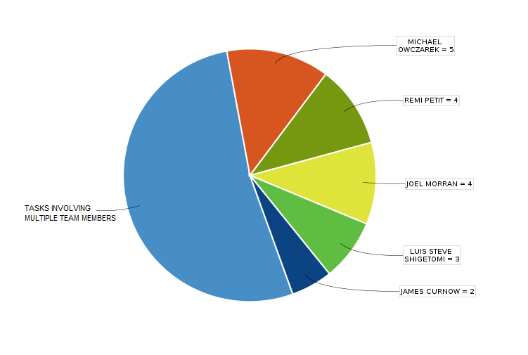
Agile (Jira)
Notes:
REMI

Slide 18
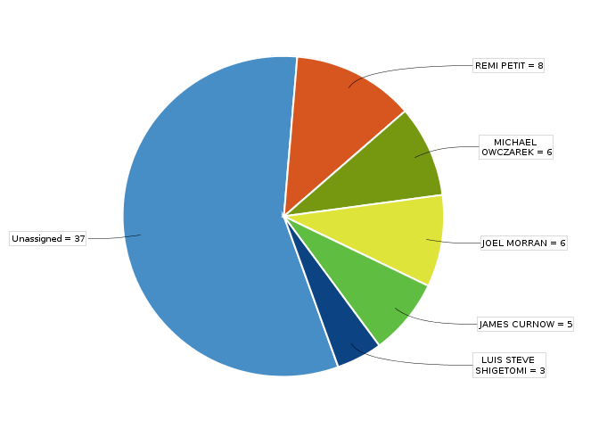
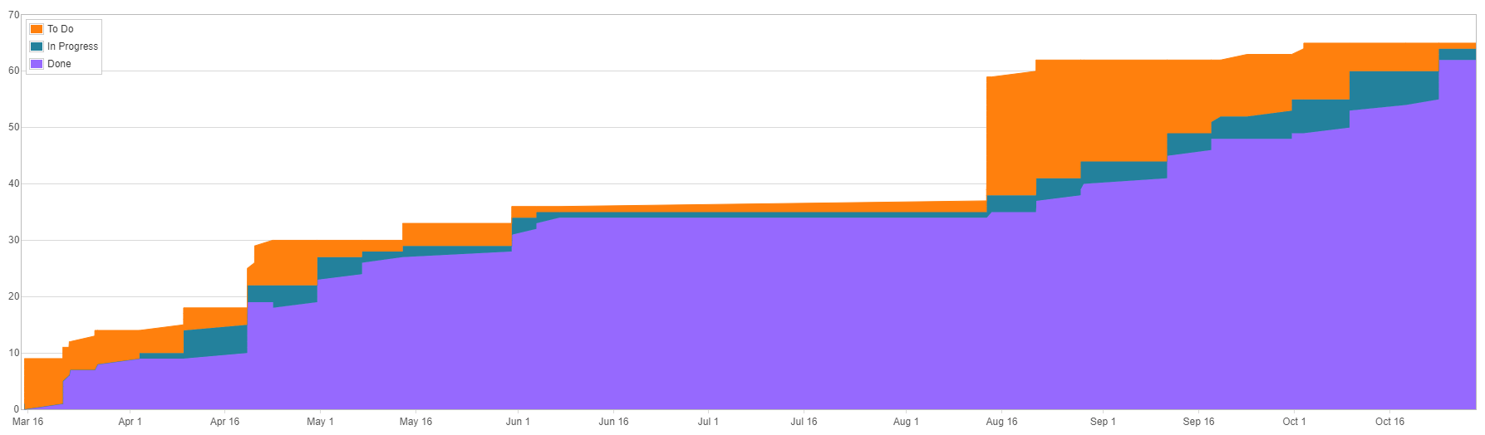
Agile Reflection
This pie chart shows an example of how tasks are divided amongst the team. Where majority of tasks are done as a team, we also have individual tasks that we do.
Cumulative Flow Diagram:
Notes:
The team clearly understands and reflects on the improvements they have made throughout the year with regards to agile methodologies, team cohesion, technical skills, communication and overall growth. The team uses metrics to demonstrate and compare improvement and evaluates any action plans they have implemented in the past. (10)

Slide 19
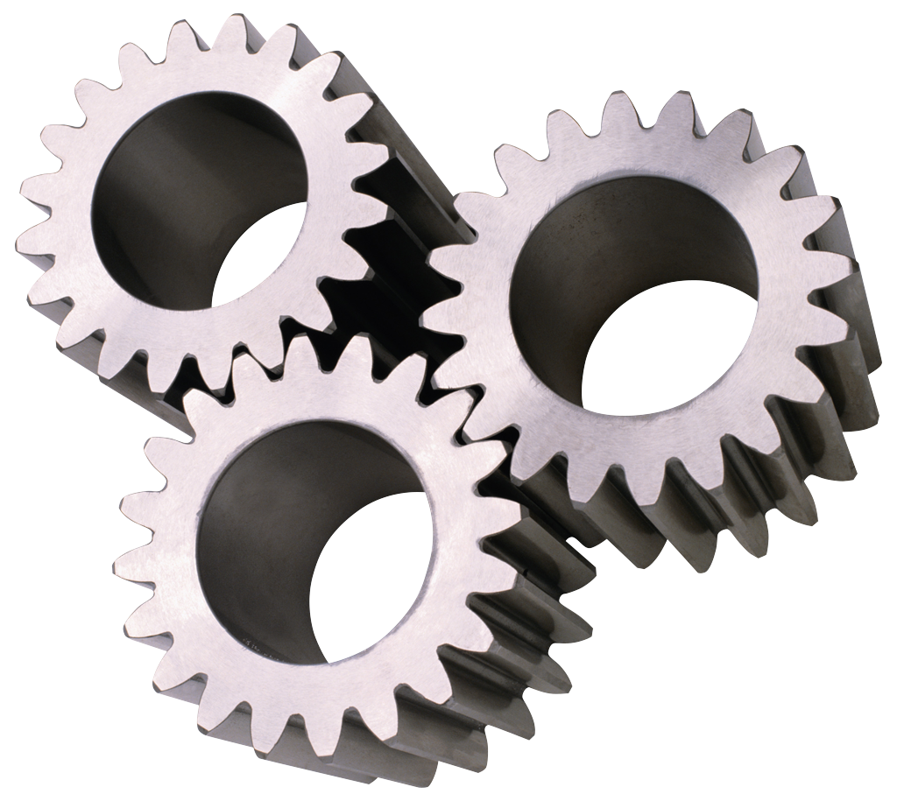
Other Modifications & Improvements
Revised user story testing
Further simplified SQL database
Power BI changes
Finalised integration of all parts of
the project
Notes:
MICHAEL

Slide 20
Implementation
Hardware sensor
Machine learning
Power BI & SQL Database (w/mock data)

Slide 21
Testing (Unit Testing)
Part of implementation
Explain how traditional unit testing can’t really be used
Show commands used to verify IoT edge is running
Joel show the thing you made last night

Slide 22
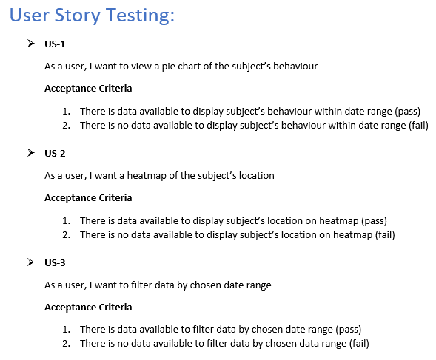
Testing (User Story Testing)
Notes:
JAMES

Slide 23
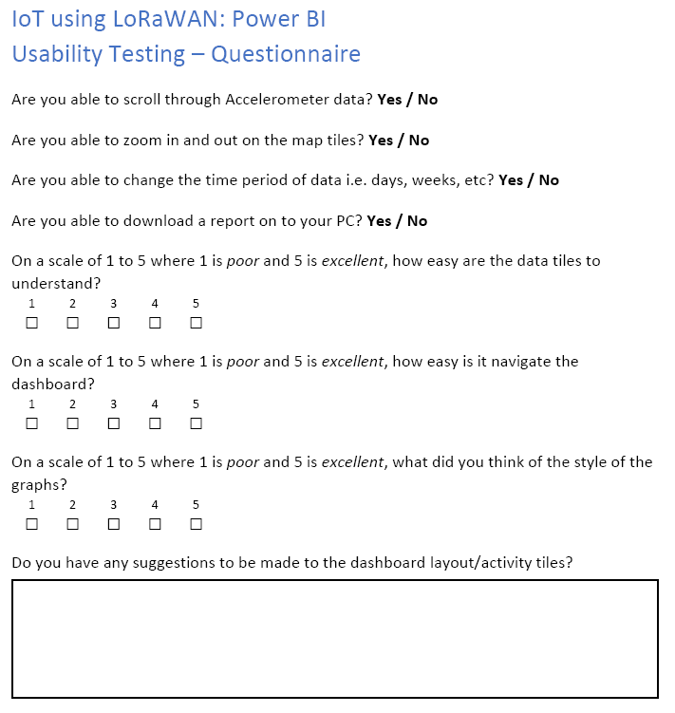
Testing (Usability Testing)
Additionally assess participants on whether:
Could users complete task?
How long did it take them?
Did they need help?
Create metrics from all pieces of data to obtain an insight into difficulties and problem areas
Notes:
REMI

Slide 24
Conclusion
What we have learned this semester
How to use Agile methodology
Teamwork and communication
New technologies
Ways to further improve our project
Additional sensors
Make device smaller as originally intended
Notes:
The team explains what they have learned throughout the semester. They summarise what they have done and how they would go on to further improve their system.(2.5)

Slide 25


Q&A

